Slide 1
ACTITIME MANUAL TESTING
PRESENTED BY:
M. MANI SATHWIKA
L. LASKMI CHAITANYA
COLLAGE NAME:MALINENI LAKSHMAIAH WOMEN’S ENGINEERING COLLAGE
INTERSHIP DOMAIN:SOFTWARE TESTING

Slide 2
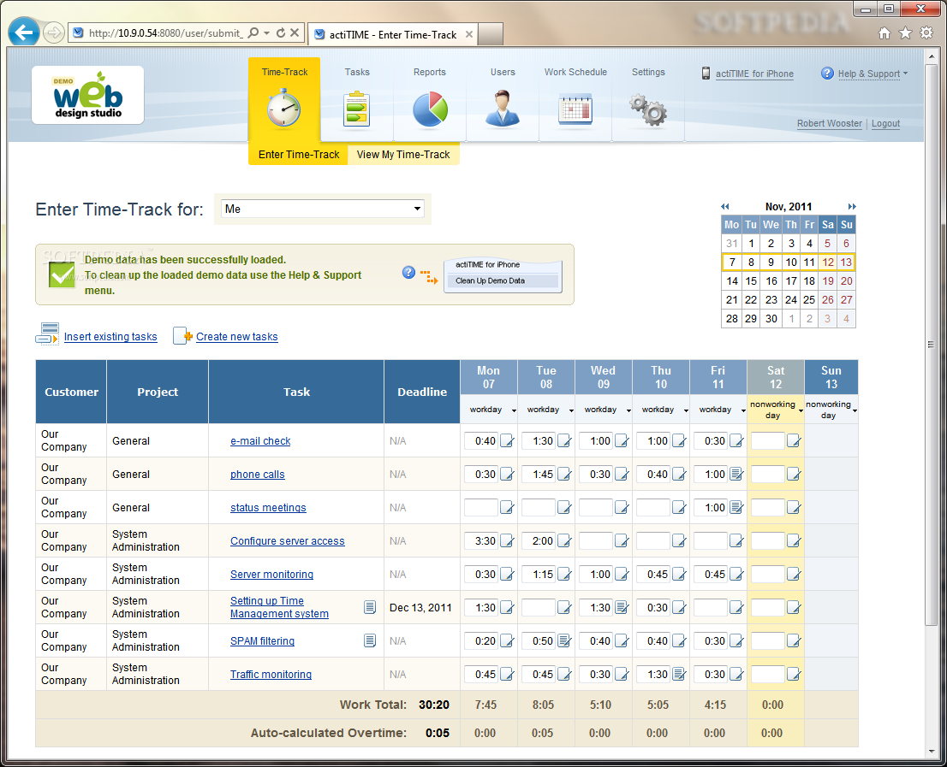
Introduction to Actitime Manual Testing
Actitime is a popular time-tracking software used for project management.
Manual testing plays a crucial role in ensuring the quality and functionality of Actitime.
Manual testing involves executing test cases manually without the use of automation tools.
1

Slide 3
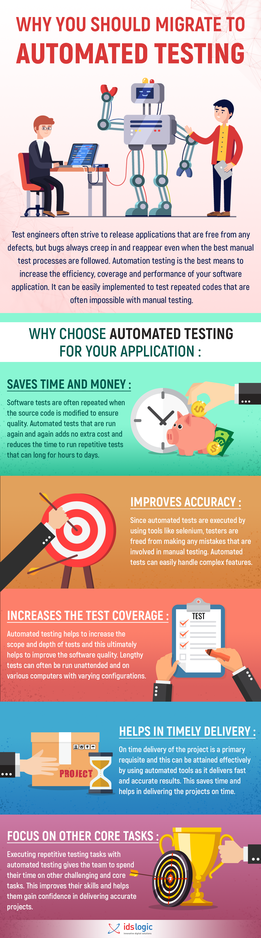
Importance of Manual Testing in Actitime
Manual testing helps identify bugs and issues that automated tests might miss.
It allows testers to evaluate the user interface and overall user experience of Actitime.
Manual testing ensures Actitime functions as intended in different environments and scenarios.
2

Slide 4
Test Case Creation in Actitime
Test cases are created based on Actitime's functional requirements and user stories.
Each test case includes a set of steps to be executed and expected results.
Test cases cover different functionalities of Actitime, including user registration, login, time tracking, and reporting.
3

Slide 5
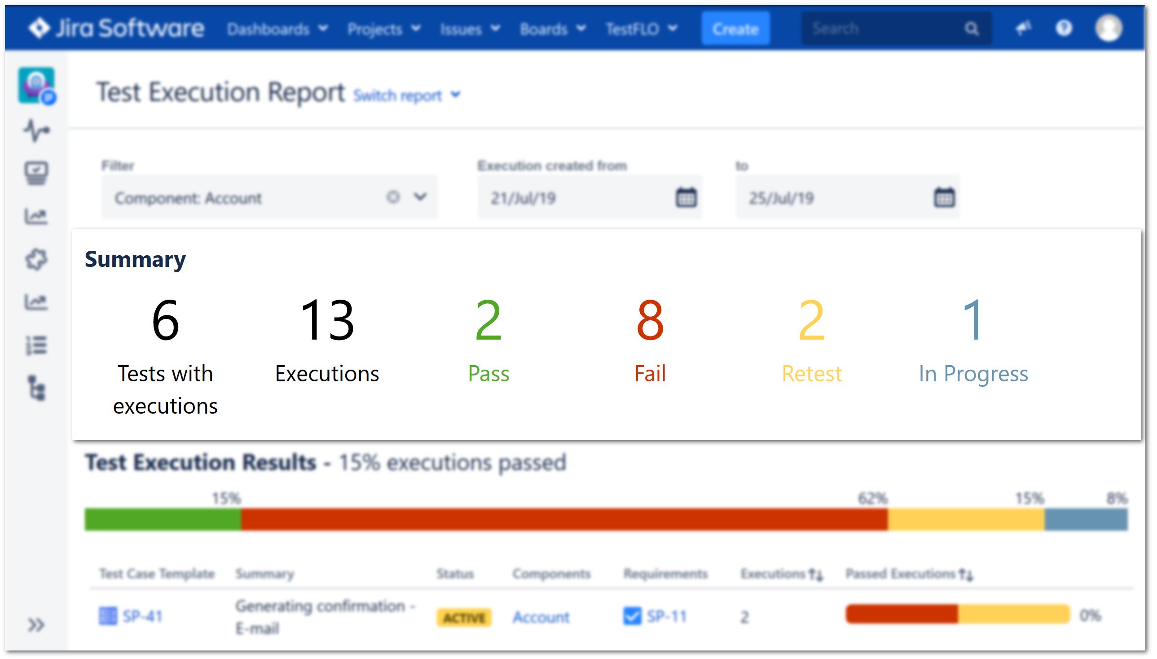
Test Execution in Actitime
Testers execute test cases step by step, following the predefined test plan.
They record actual results, compare them with expected results, and report any deviations.
Testers also document any issues or bugs encountered during test execution.
4

Slide 6

Regression Testing in Actitime
Regression testing is performed after bug fixes or software updates to ensure Actitime's existing functionalities are intact.
Testers rerun previously executed test cases to verify that the system is not affected by recent changes.
Regression testing helps maintain Actitime's stability and reliability.
5

Slide 7
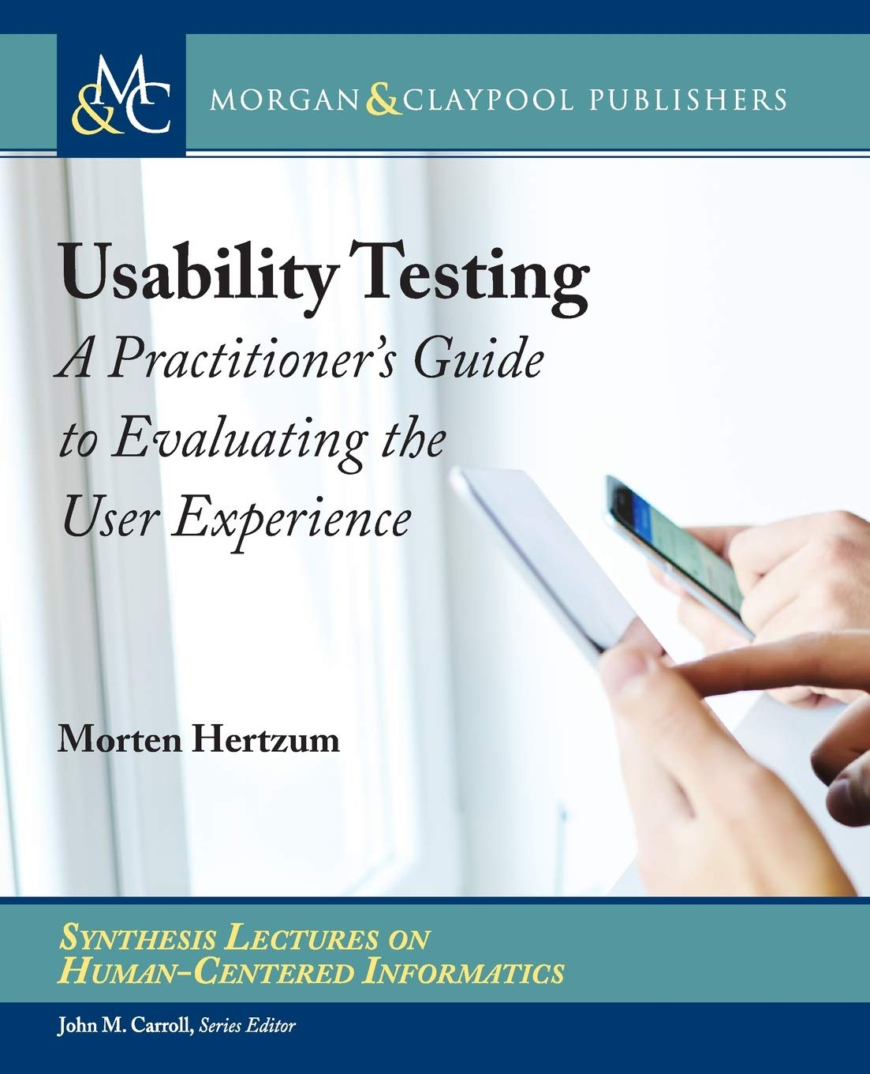
Usability Testing in Actitime
Usability testing focuses on evaluating Actitime's ease of use and user-friendliness.
Testers assess Actitime's navigation, intuitiveness, and overall user experience.
Feedback from usability testing helps improve Actitime's interface and enhance user satisfaction.
6

Slide 8
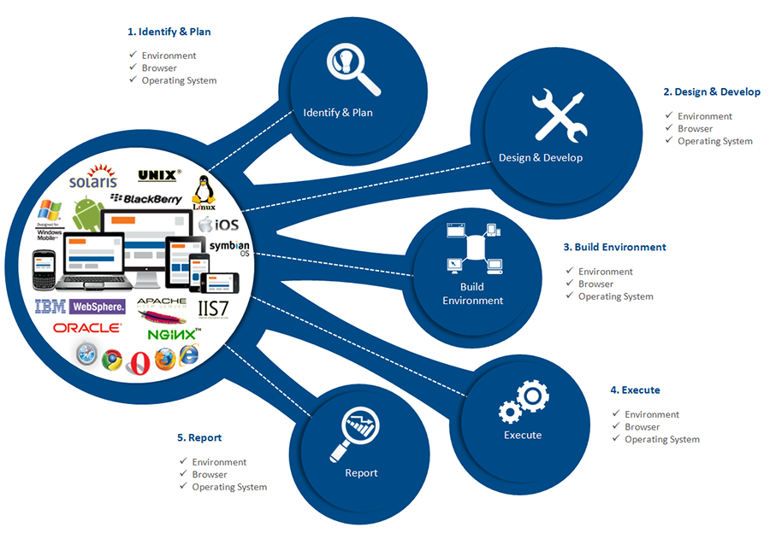
Compatibility Testing in Actitime
Compatibility testing ensures Actitime works seamlessly across different browsers, operating systems, and devices.
Testers validate Actitime's compatibility with popular browsers like Chrome, Firefox, and Edge.
Compatibility testing also covers different operating systems such as Windows, macOS, and Linux.
7

Slide 9
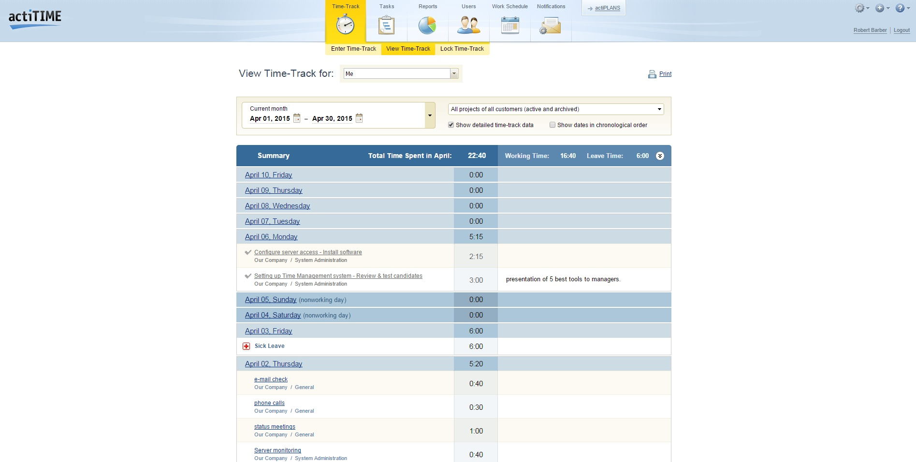
Performance Testing in Actitime
Performance testing assesses Actitime's speed, response time, and overall system performance.
Testers simulate high user loads to measure Actitime's performance under stress.
Performance testing helps identify bottlenecks and optimize Actitime's performance.
8

Slide 10
Security Testing in Actitime
Security testing ensures Actitime's data protection measures and user authentication mechanisms are robust.
Testers verify if Actitime encrypts sensitive data, prevents unauthorized access, and follows best security practices.
Security testing helps maintain Actitime's integrity and protects user information.
9

Slide 11
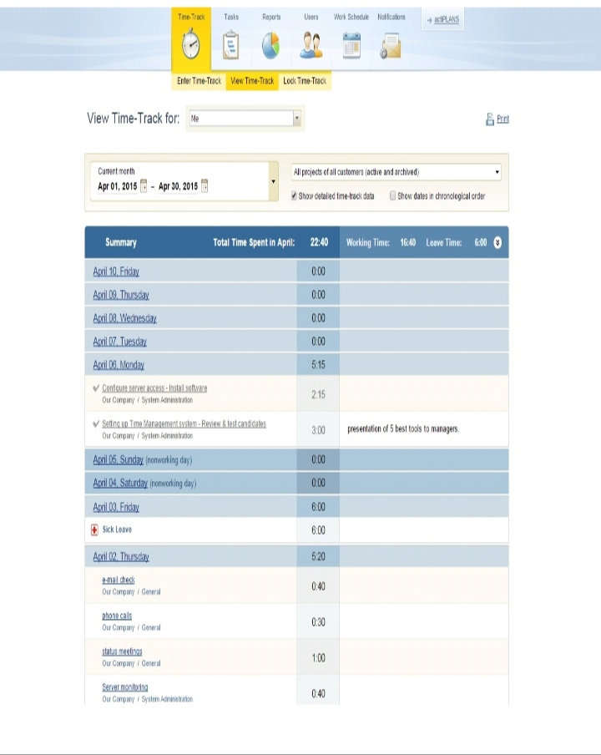
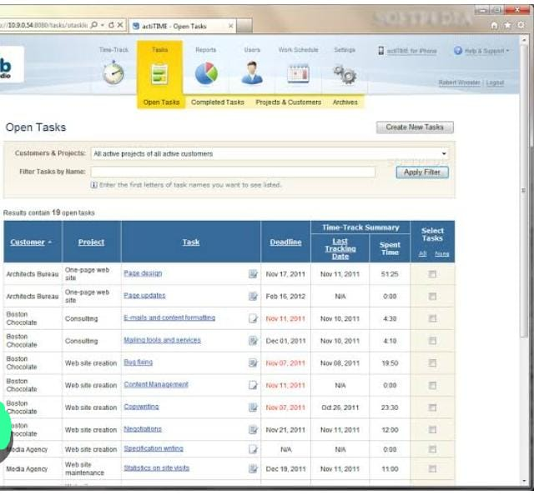
Result
Manual testing plays a virtual role in ensuring Acttime quality,usability,compatibility,performance,and security

Slide 12
Conclusion
Manual testing plays a vital role in ensuring Actitime's quality, usability, compatibility, performance, and security.
Testers meticulously execute test cases, identify bugs, and provide valuable feedback for Actitime's improvement.
Continuous manual testing helps maintain Actitime's reliability and enhances user satisfaction.
10

Slide 13
LINK:
https://github.com/Sathwika58/Actitime-Manual-Testing/upload/main/Document

Slide 14
Thank you

